Slide 1
Lab 3 Composite, Strategy and Decorator Patterns -- 01
Please download the corresponding materials

Slide 2
Before introducing the lab, please pay attention to the following issues:
1, sign in the attendance sheet (20% point deduction for absence);
2, the due (02/14/2018);
3, demo: any labs or office hours before the deadline (redemo is okay); the lab after two weeks (02/14/2018) (redemo is not allowed)
4, please finish the lab with one of your classmates (i.e., two members in a group), individual assignment is allowed
5, introduce: Composite and Strategy Pattern (this lab), Decorator Pattern (next lab)

Slide 3
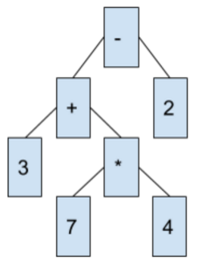
Composite Pattern
Calculation?
Expression: 3 + 7 *4 - 2
Result: 29

Slide 4
Composite Pattern
Use Composite Pattern to implement the expression tree
Your program should be able to get the value of expression tree
Base Class: fundamental, parent class for all other classes
Op Class: a number, leaf node in the tree
Add, Substract, Multiply, Divide: calculate on two child trees (Base*)
Square: operate on one child tree (Base*)

Slide 5
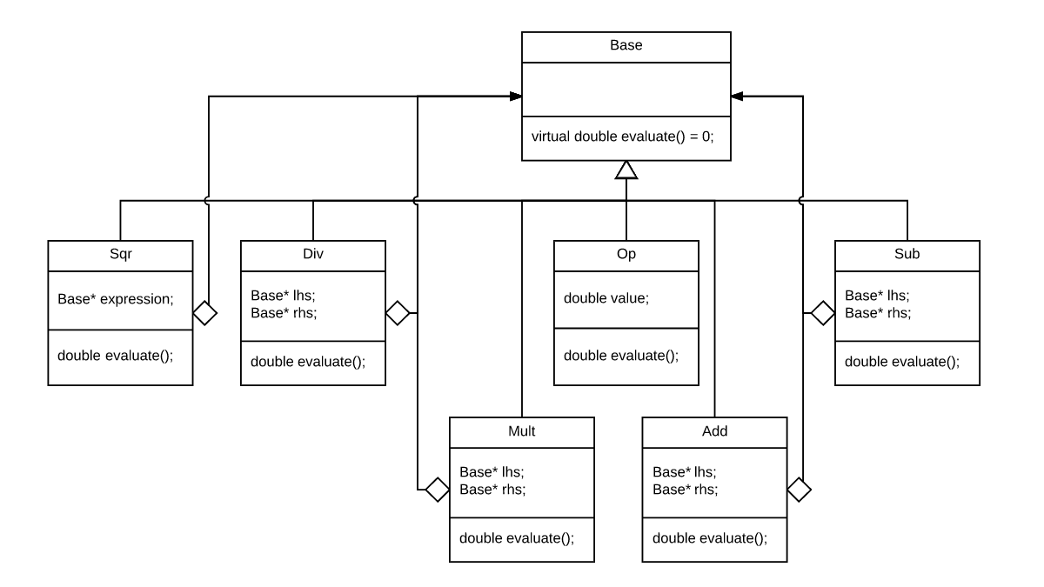
Composite Pattern
Notes:
Any questions so far?

Slide 6
Strategy Pattern
Based on Composite Pattern
Containers: save and manage multiple expression (Base*) trees
VectorContainer: sequential table, vector in C++ STL
(#include <vector>)
4. ListContainer: linked list table, list in C++ STL
(#include <list>)

Slide 7
Strategy Pattern
Sort: sorting a container based on the values of trees
Selection Sort and Bubble Sort: two sub classes of Sort

Slide 8
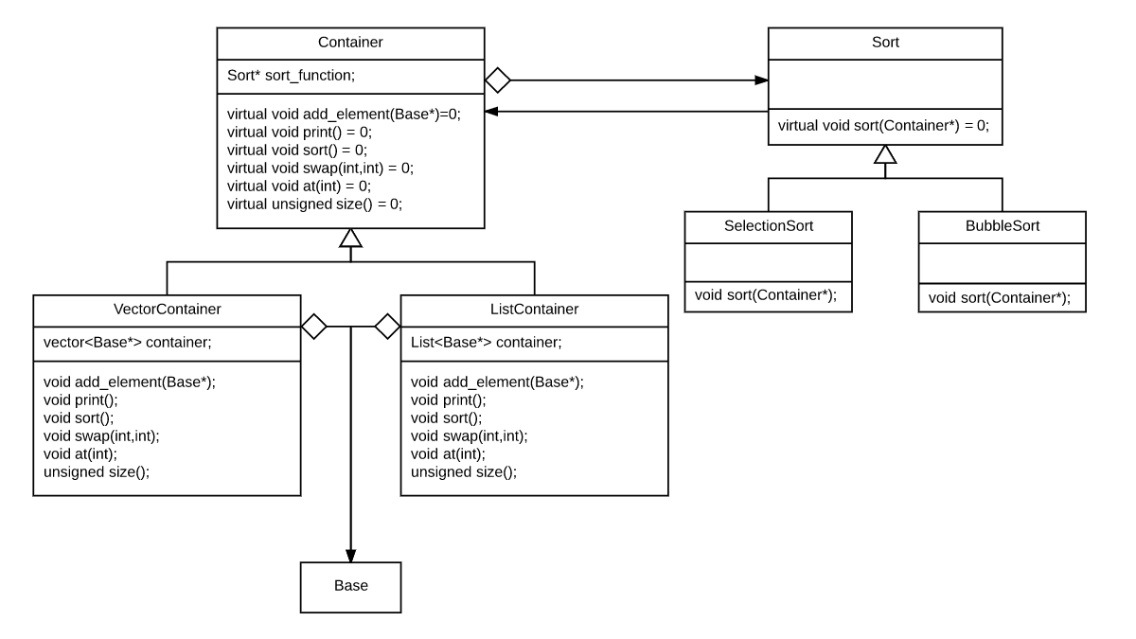
Strategy Pattern

Slide 9
Testing Program
Create a tree that includes different types of nodes (e.g Add, Sub, Div etc)
Test combinations of containers and sorting functions
(e.g VectorContainer + SelectionSort, ListContainer + BubbleSort etc)
3. See test.cpp in your lab repository

Slide 10
Decorator Pattern
Upcoming …

